Slide 1
Permaculture
Permanent + Culture
Permanent + Agriculture

Slide 3
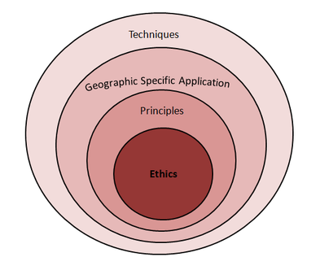
Permaculture Core Ethics
Design
Care for Earth
Care for People
Limit Consumption/Fair Share
Notes:
Desi

Slide 4
Permaculture
Permaculture integrates people into Nature's design. A permaculture design provides us with shelter, food, water, income, community and aesthetic and spiritual fulfillment within a balanced and healthy biological community.
Permaculture is Applied Science and Ecology; Ethical design of human systems for a sustainable future. It offers practical solutions to the global environmental and cultural crises we now face.
Permaculture (Permanent Culture) is the conscious design and co-creative evolution of agriculturally productive ecosystems and cooperative and economically just social systems which have the diversity, stability and resilience of 'natural' systems. The practice and development of liberating mental, emotional and spiritual ways of being. It seeks to provide a sustainable and secure place for living things on this earth.

Slide 5
Permaculture
Permaculture is a body of knowledge, susceptible to learning & teaching. But it is also a way of organizing knowledge, a connecting system that integrates science, art, politics, anthropology, sociology, psychology, & the diverse experiences & resources available in any community.
Permaculture is an ethical design system for creating human environments that are ecologically sound & economically viable. Permaculture systems provide for their own needs, do not exploit or pollute, & are therefore sustainable.

Slide 6
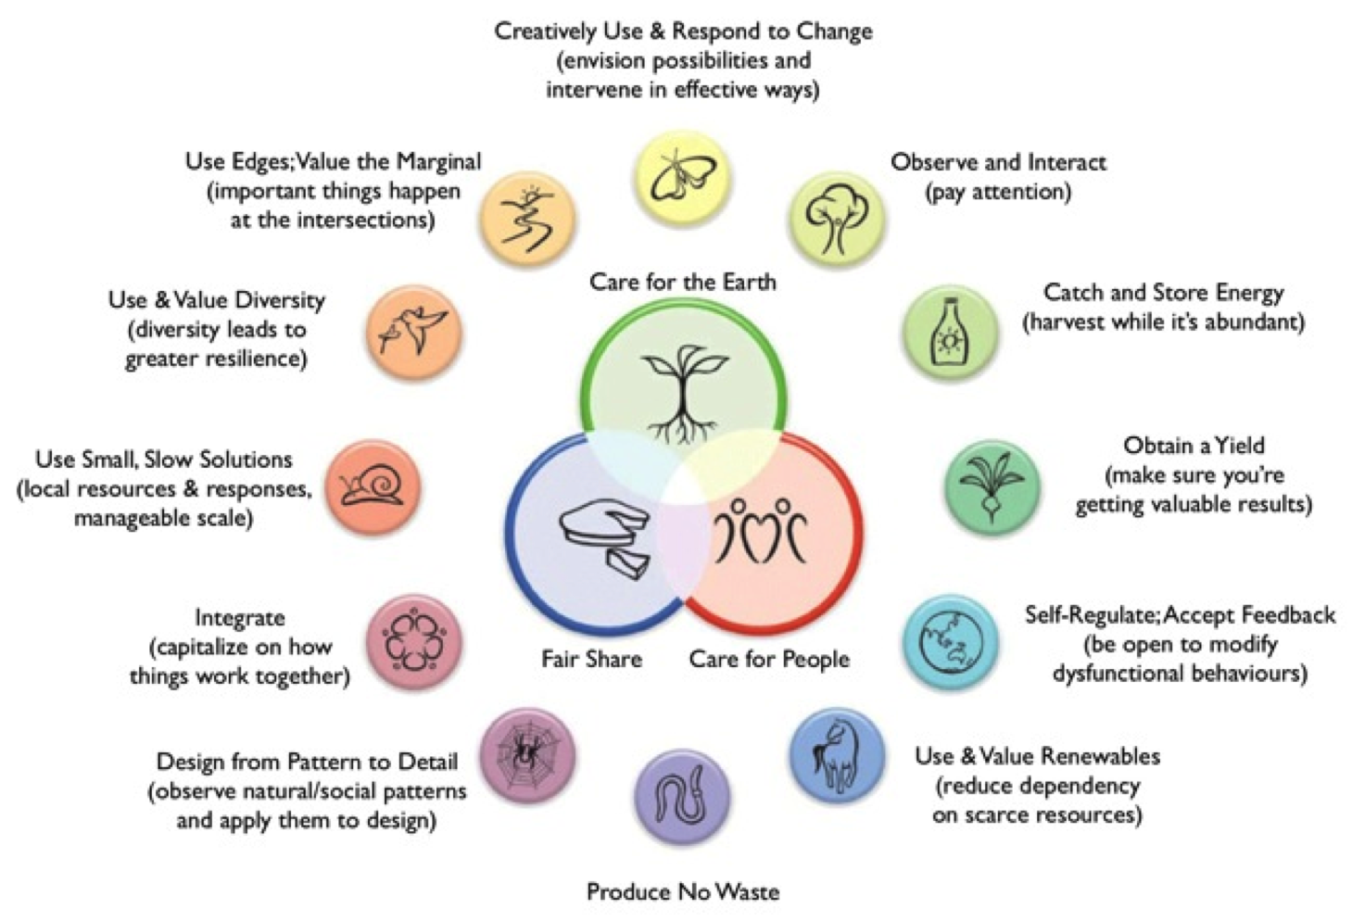
Permaculture Principles

Slide 7
Permaculture Design Applications: Economics
“Financial Permaculture” is the design and management of business and monetary systems that increase ecological health while meeting human needs. Creating a Financial Permaculture is a design endeavor towards circulating money locally, and finding innovative ways to promote trading and exchange systems that align with ecological patterns and boundaries.It is devoid of the notions of debt and credit which riddle modern human culture and which are entirely absent from the wilderness.
Financial Permaculture Institute’s Design Principles
Decentralization is better than centralization
Participatory design is true democracy
Land based businesses that use permaculture as a foundation of their design
Financial Intimacy creates closely knit and resilience communities
Notes:
“Financial Permaculture” is the design and management of business and monetary systems that increase ecological health while meeting human needs. Creating a Financial Permaculture is a design endeavor towards circulating money locally, and finding innovative ways to promote trading and exchange systems that align with ecological patterns and boundaries.
Financial Permaculture Institute’s Design Principles
Decentralization is better than centralization. The current financial system is linear and centralized, and is designed to continually further centralize power and wealth. We must find ways to decentralize power and wealth so that people within a given community can make well informed, well resourced, and locally appropriate decisions.
Participatory design is true democracy. By empowering people with the process and tools needed to take decision-making into their own hands, we tap into the wisdom and fresh thinking of previously unheard voices.
Land based businesses that use permaculture as a foundation of their design; production and distribution processes are the best investments and form the foundation of any viable long-term economy.
Financial Intimacy creates closely knit and resilience communities. Invest in local enterprise. Invest in the dreams you share with friends, family and community. Become a stakeholder in your vision for a better world.
"Wild economics is the convergence of permaculture principles with gift economics," says Mark.Wild economics is where the growing movement to localise our lives meets with the emerging desire of people across the world to relate to each other in a much more inspiring and uplifting way. It is a form of economy that replicates and draws its inspiration from Nature, where people can share their gifts with each other in a way that adds fertility to both the Earth and their local communities. It is devoid of the notions of debt and credit which riddle modern human culture and which are entirely absent from the wilderness.
“Financial Permaculture” is the design and management of business and monetary systems that increase ecological health while meeting human needs. Creating a Financial Permaculture is a design endeavor towards circulating money locally, and finding innovative ways to promote trading and exchange systems that align with ecological patterns and boundaries.
Financial Permaculture Institute’s Design Principles
Decentralization is better than centralization. The current financial system is linear and centralized, and is designed to continually further centralize power and wealth. We must find ways to decentralize power and wealth so that people within a given community can make well informed, well resourced, and locally appropriate decisions.
Participatory design is true democracy. By empowering people with the process and tools needed to take decision-making into their own hands, we tap into the wisdom and fresh thinking of previously unheard voices.
Land based businesses that use permaculture as a foundation of their design; production and distribution processes are the best investments and form the foundation of any viable long-term economy.
Financial Intimacy creates closely knit and resilience communities. Invest in local enterprise. Invest in the dreams you share with friends, family and community. Become a stakeholder in your vision for a better world.
"Wild economics is the convergence of permaculture principles with gift economics," says Mark.Wild economics is where the growing movement to localise our lives meets with the emerging desire of people across the world to relate to each other in a much more inspiring and uplifting way. It is a form of economy that replicates and draws its inspiration from Nature, where people can share their gifts with each other in a way that adds fertility to both the Earth and their local communities. It is devoid of the notions of debt and credit which riddle modern human culture and which are entirely absent from the wilderness.

Slide 8
Permaculture Design Applications: Food and Climate Change
Food Forests and More...
Biotechnologists firmly believe that humanity’s ‘salvation’ lies in them ‘engineering’ staple crops through genetic modification to provide all our needs and save humanity from starvation.
By understanding how forests grow and sustain themselves without human intervention, we can learn from Nature, copy the systems and patterns to model our own forests — ones filled with trees and plants that produce food we can eat.
Real forests don’t need any work, they self-maintain — no pesticides, herbicides, weeding, crop rotation, mowing or digging. Food forests don’t need any of this either! Less work, more food, all natural! Why would you do anything else?
Notes:
“Financial Permaculture” is the design and management of business and monetary systems that increase ecological health while meeting human needs. Creating a Financial Permaculture is a design endeavor towards circulating money locally, and finding innovative ways to promote trading and exchange systems that align with ecological patterns and boundaries.
Financial Permaculture Institute’s Design Principles
Decentralization is better than centralization. The current financial system is linear and centralized, and is designed to continually further centralize power and wealth. We must find ways to decentralize power and wealth so that people within a given community can make well informed, well resourced, and locally appropriate decisions.
Participatory design is true democracy. By empowering people with the process and tools needed to take decision-making into their own hands, we tap into the wisdom and fresh thinking of previously unheard voices.
Land based businesses that use permaculture as a foundation of their design; production and distribution processes are the best investments and form the foundation of any viable long-term economy.
Financial Intimacy creates closely knit and resilience communities. Invest in local enterprise. Invest in the dreams you share with friends, family and community. Become a stakeholder in your vision for a better world.
"Wild economics is the convergence of permaculture principles with gift economics," says Mark.Wild economics is where the growing movement to localise our lives meets with the emerging desire of people across the world to relate to each other in a much more inspiring and uplifting way. It is a form of economy that replicates and draws its inspiration from Nature, where people can share their gifts with each other in a way that adds fertility to both the Earth and their local communities. It is devoid of the notions of debt and credit which riddle modern human culture and which are entirely absent from the wilderness.
“Financial Permaculture” is the design and management of business and monetary systems that increase ecological health while meeting human needs. Creating a Financial Permaculture is a design endeavor towards circulating money locally, and finding innovative ways to promote trading and exchange systems that align with ecological patterns and boundaries.
Financial Permaculture Institute’s Design Principles
Decentralization is better than centralization. The current financial system is linear and centralized, and is designed to continually further centralize power and wealth. We must find ways to decentralize power and wealth so that people within a given community can make well informed, well resourced, and locally appropriate decisions.
Participatory design is true democracy. By empowering people with the process and tools needed to take decision-making into their own hands, we tap into the wisdom and fresh thinking of previously unheard voices.
Land based businesses that use permaculture as a foundation of their design; production and distribution processes are the best investments and form the foundation of any viable long-term economy.
Financial Intimacy creates closely knit and resilience communities. Invest in local enterprise. Invest in the dreams you share with friends, family and community. Become a stakeholder in your vision for a better world.
"Wild economics is the convergence of permaculture principles with gift economics," says Mark.Wild economics is where the growing movement to localise our lives meets with the emerging desire of people across the world to relate to each other in a much more inspiring and uplifting way. It is a form of economy that replicates and draws its inspiration from Nature, where people can share their gifts with each other in a way that adds fertility to both the Earth and their local communities. It is devoid of the notions of debt and credit which riddle modern human culture and which are entirely absent from the wilderness.

Slide 9
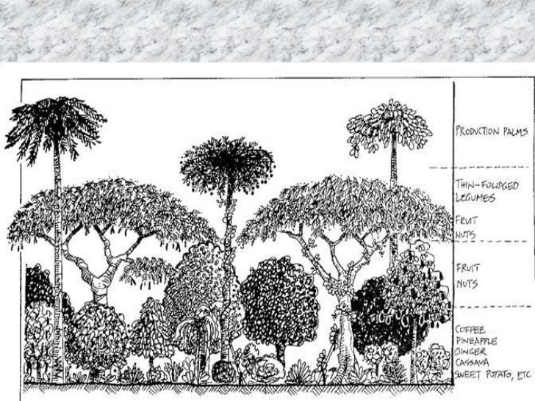
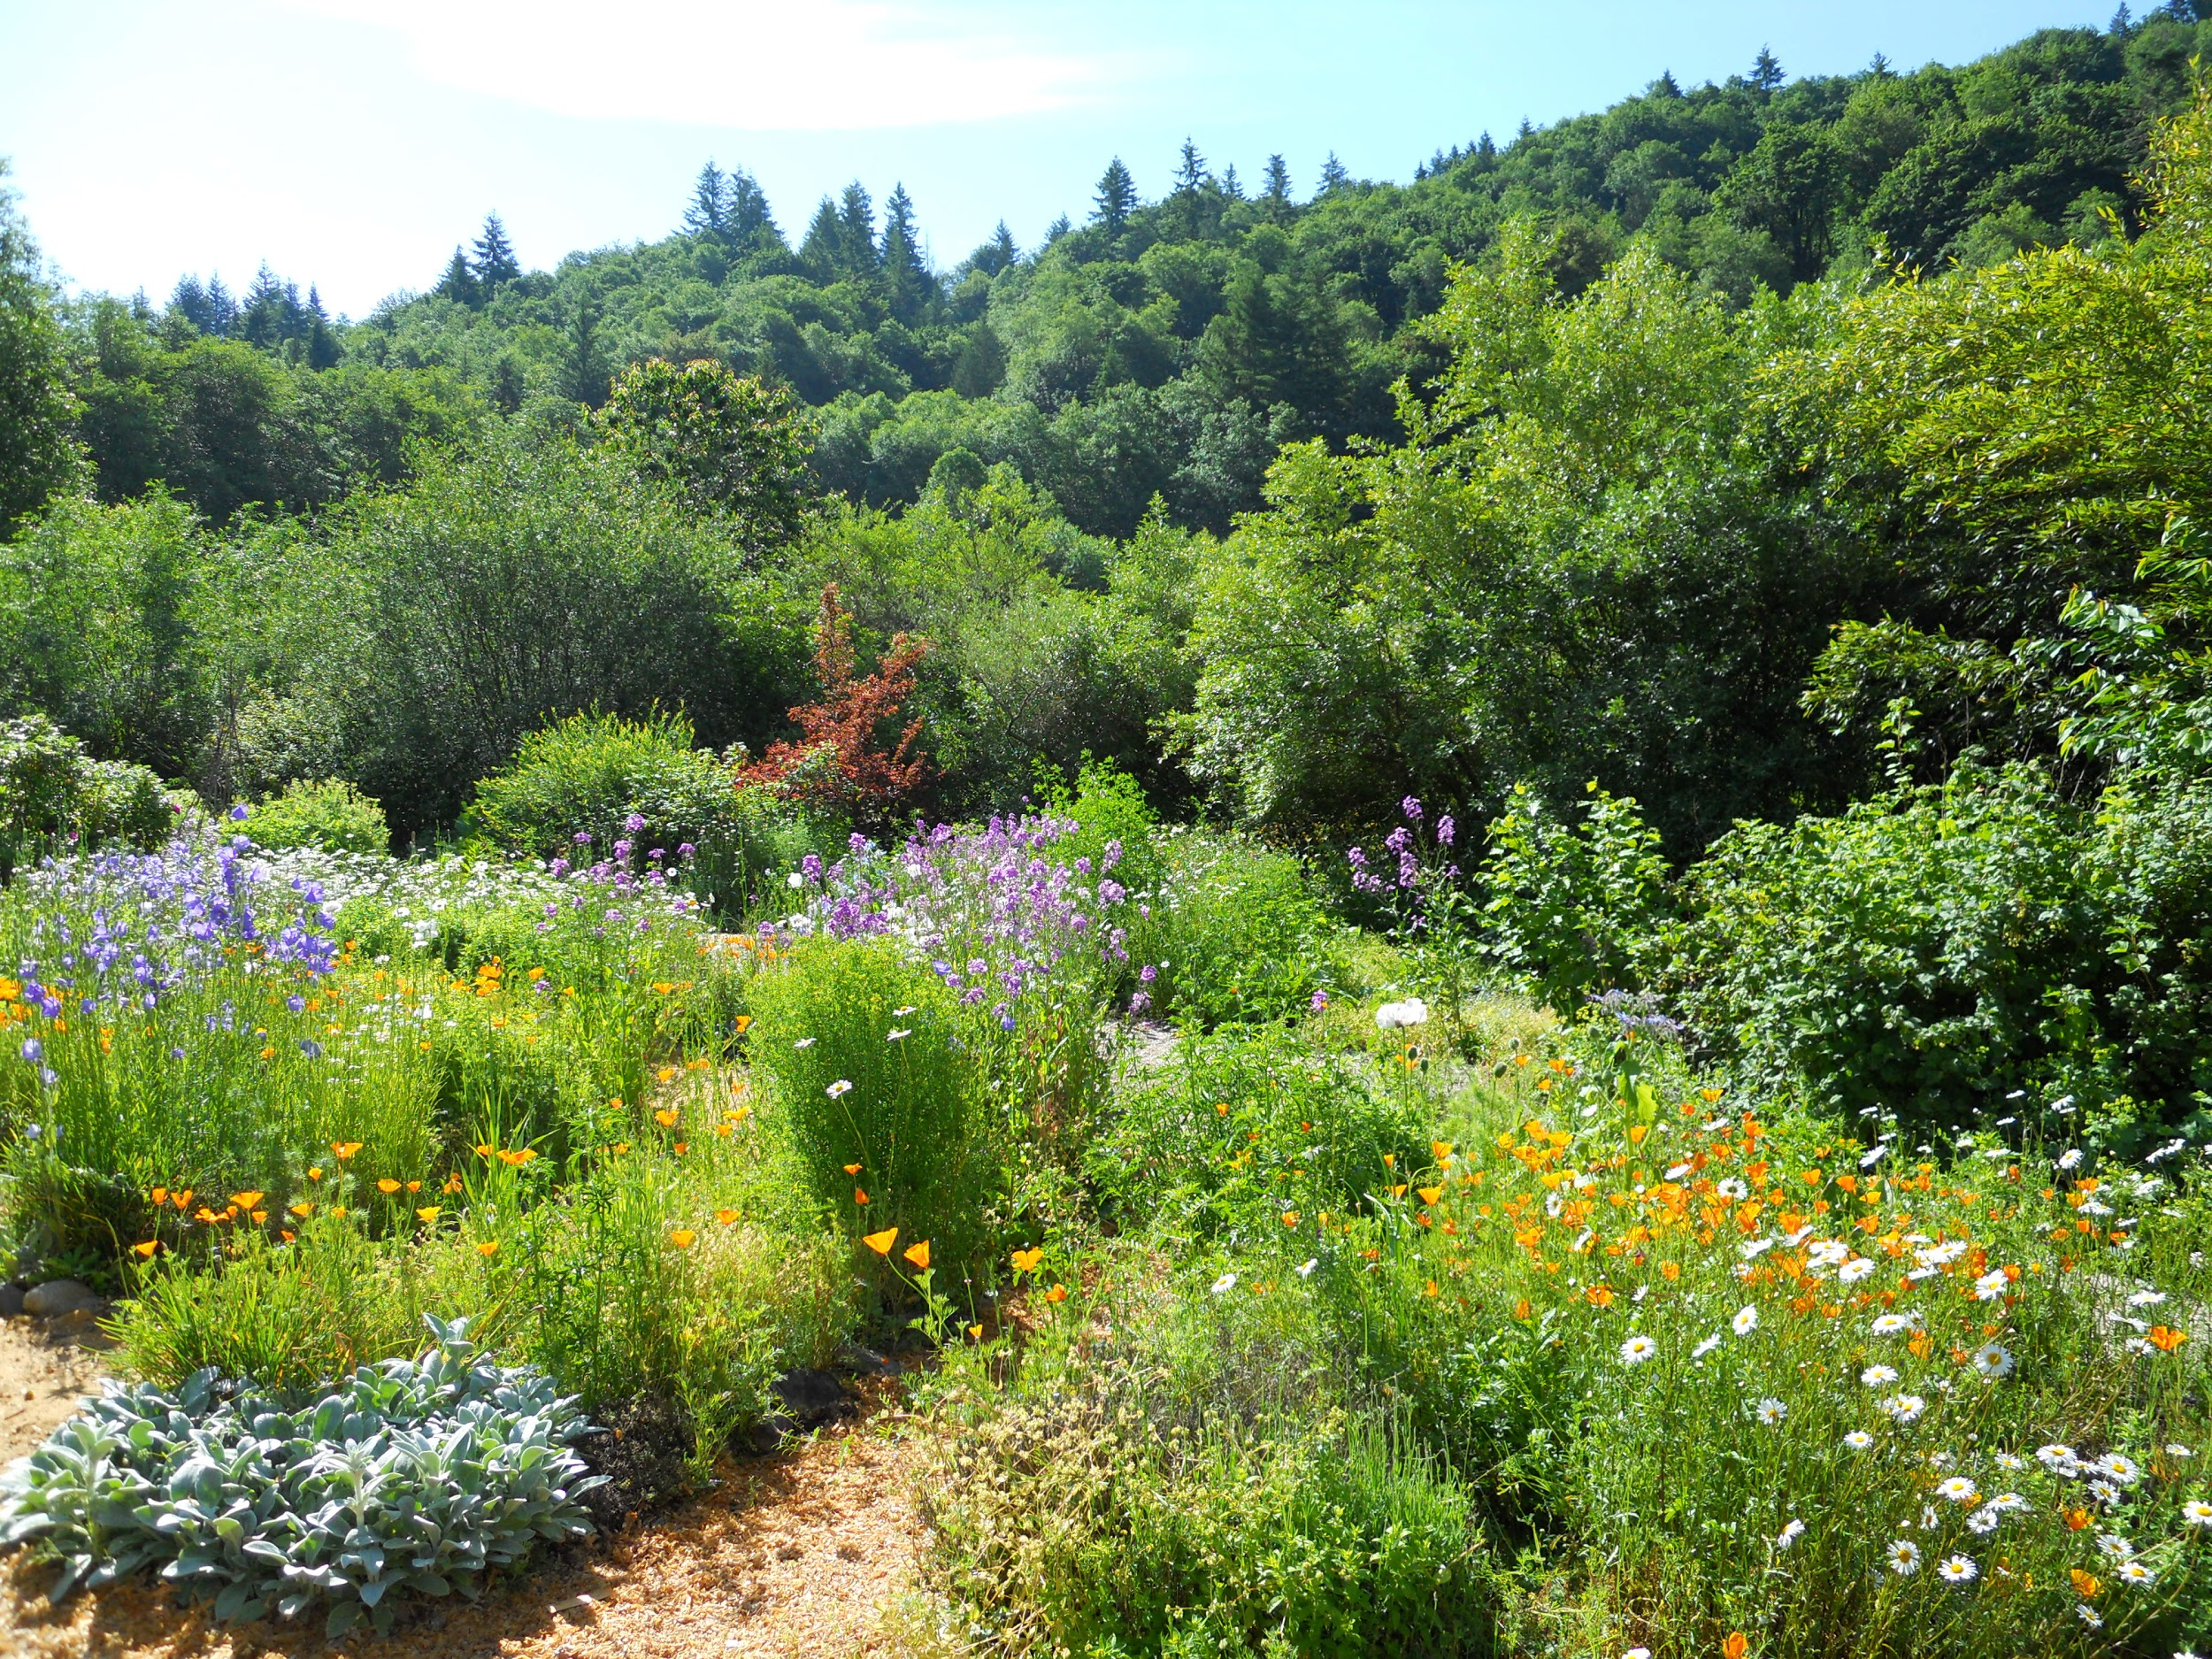
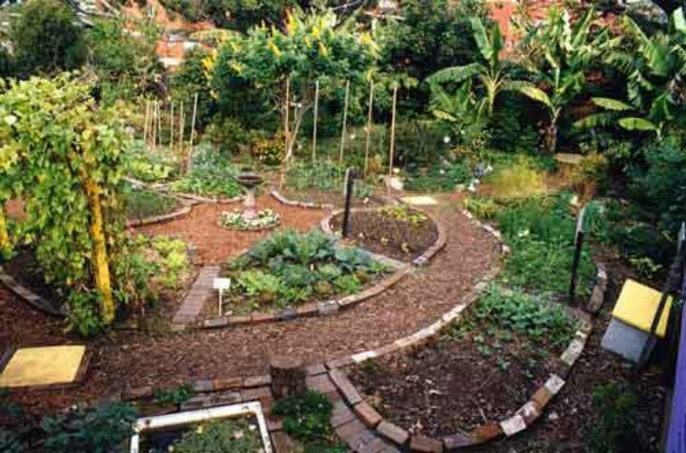
What if our gardens at
AP looked like this?

Slide 10
Permaculture Design Applications: Energy and Policy
Biogeoregions: Energy decisions and policies to be made based on biological, geological, and geographical aspects of the land.
Fossil Fuel Free Landscapes: Using fossil fuels to create landscapes that will no longer need fossil fuels
Passive Systems: Harnessing and creating as many passive systems for water and energy cycling as possible
Scaling Up: In nature there is no scaling up except within a biogeoregion. We can design permaculture homes, farms, villages, towns, cities, and regions.

Slide 11
Changing the World

Slide 12
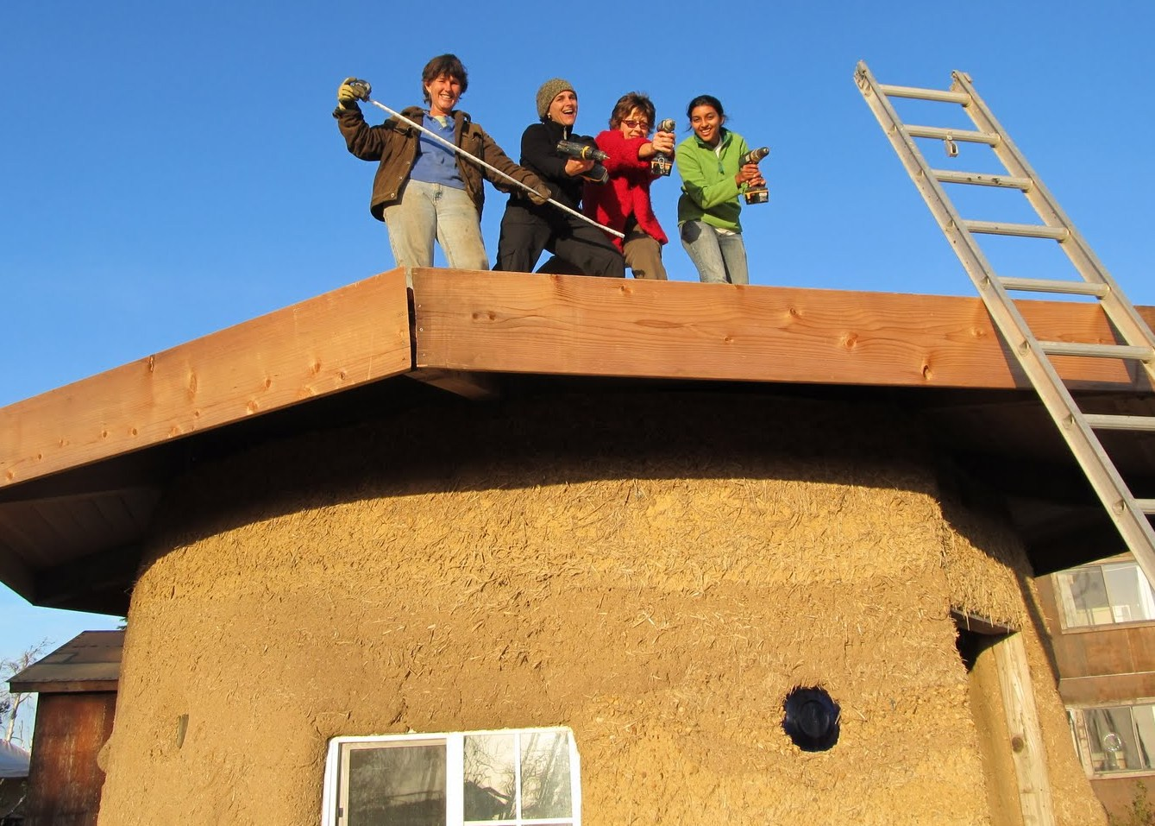
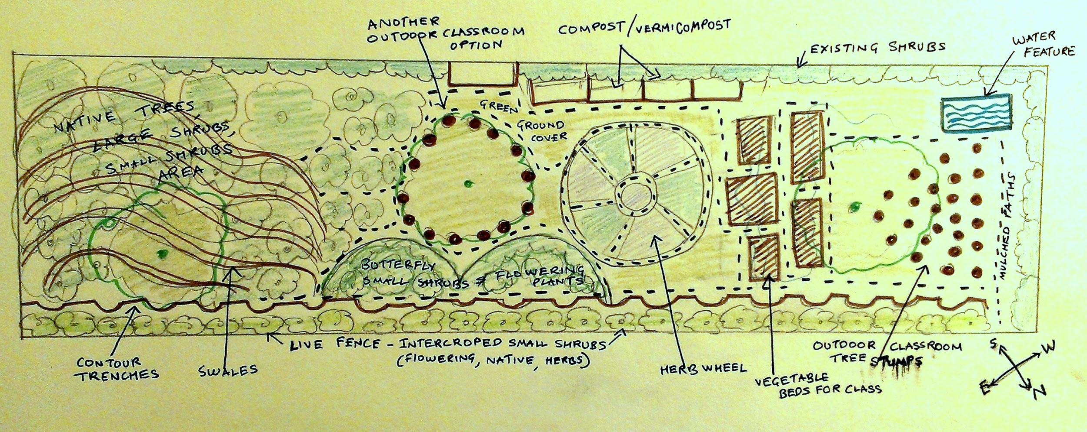
My Permaculture Dream
Design for my
land & community

Slide 13
Are we willing to make these deep lifestyle changes in our own lives? To jump out of the vicious cycle and live alternatively?

Slide 15
"Permaculture is revolution disguised as gardening."
Mike Feingold, a Permaculture Teacher at Findhorn
Thank you!
Anandi 29/05/15
http://emotionallandscapes.weebly.com

Slide 16
Links
Articles and Websites
http://www.hopedance.org/index.php/home/soul-news/996
http://permacultureprinciples.com/
http://permaculturenews.org/2011/10/21/why-food-forests/
http://2014.financialpermaculture.com/finanacial-permaculture.html
http://www.perennialsolutions.org/financial-permaculture-organizing-communities-to-manage-resources-with-perennial-objectives-ends.html#article
http://www.financialpermaculture.org/
http://emotionallandscapes.weebly.com/permaculture
http://www.permaculture.co.uk/articles/wild-economics-interview-mark-boyle
Videos
https://www.youtube.com/watch?v=Wxc0wgbh_As&list=RDWxc0wgbh_As&index=1
http://permaculturesongs.com/
http://www.permaculture.co.uk/articles/power-poetry-move-us-action
http://permacultureprinciples.com/downloads/Pc_Principles_Poster_EN.pdf
https://www.youtube.com/watch?v=TVS45dbNL-E
https://www.youtube.com/watch?v=9U56O6LDyLQ
https://www.youtube.com/watch?v=4Gjtoj1V35U

